Slide 1


U.S. Bureau of Barbarians of Land Mismanagement
“During the 1970’s the Fish and Wildlife Service (FWS), in conjunction with the Bureau of Land Management (BLM), took a different approach to get the ranchers to sell. Ranchers were told that, “grazing was detrimental to wildlife and must be reduced”. 32 out of 53 permits were revoked and many ranchers were forced to leave” See Slide 5
This turtle is heading home to the Bundy Family Ranch to his real friends
Quoth the Turtle
Nevermore
BLM & FWS
Click to Dismantle the EPA
Most everyone loves turtles, except when you start labeling them to launder environmental extremism over ranchers livelihood and lives, then the line in the sand is crossed.
“We are fast approaching the stage of the ultimate inversion: the stage where the government is free to do anything it pleases, while the citizens may act only by permission; which is the stage of the darkest periods of human history, the stage of rule by brute force.”
Ayn Rand

Slide 2
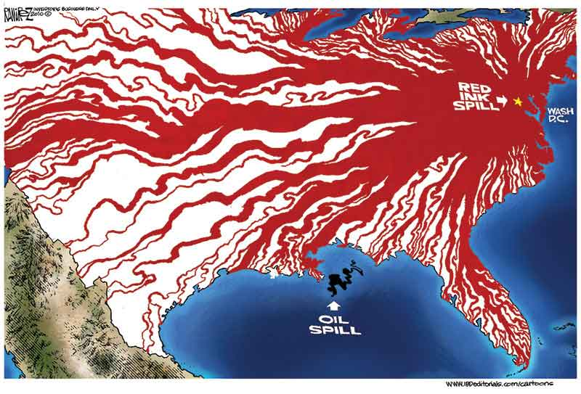
The Predatory Federal Judiciary
“...the Federal Judiciary; an irresponsible body (for impeachment is scarcely a scarecrow), working like gravity by night and by day, gaining a little today and a little tomorrow, and advancing it's noiseless step like a thief, over the field of jurisdiction, until all shall be usurped from the States, and the government of all be consolidated into one. ... when all government ... in little as in great things, shall be drawn to Washington as the centre of all power, it will render powerless the checks provided of one government on another and will become as venal and oppressive as the government from which we separated."
Thomas Jefferson, 1821
US FWS
US DOI
DeCeit, Inc.
US BLM
IRS

Slide 3
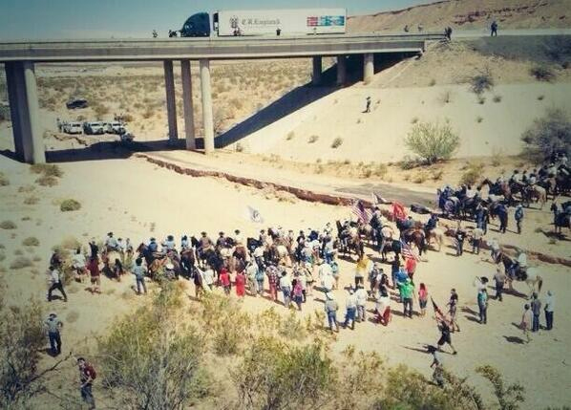
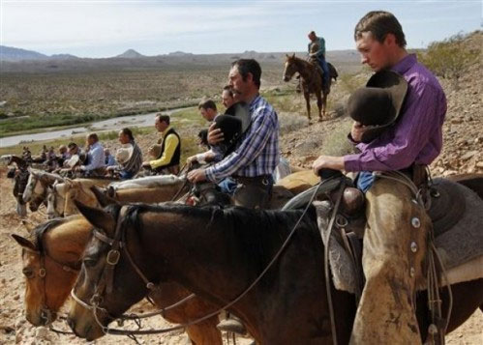
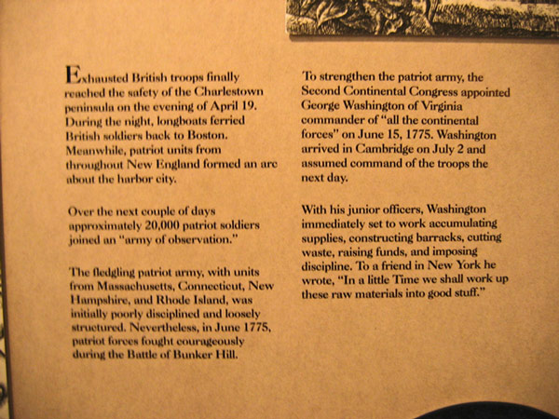
First Standoff - Bundy Ranch vs. BLM – March 2014
“To exercise exclusive Legislation…not exceeding ten Miles square as may….fore the Erection of Forts, Magazines, Arsenals, dock-Yards, and other needful Buildings…”
U.S. Constitution, Art. I, Sect. 8, Clause 17.
“Without a cession, the U.S. has no jurisdiction.
The feds must prove ownership AND state cession of jurisdiction.”
“We think a proper examination of this subject will show that the United states never held any municipal sovereignty, jurisdiction, or right of soil in and to the territory, of which Alabama or any of the new States were formed,” 44 U.S. at 221.
“The Federal Government cannot, by unilateral action on its part, acquire legislative jurisdiction over any area within the exterior boundaries of a State," Id., at 46.”
Lowell H. Becraft, Jr., Attorney
Federal Jurisdiction Must Read
https://redoubtnews.com/2017/08/federal-land-violate-constitution/
British Retreat vs. BLM Retreat
Do you see a difference between the report above re. armed British troops occupying and invading the colonies in 1775 and armed gvt. serial agencies invading our land now? I don’t.
Turtles For the BLM Or Cows For Bundy
“Turtles for cows, open range for kings land? In the good old USA! By the stroke of a pen some politician can rake in the cash if he can stand for a cause that he can sell the public. First he's got to have a victim, a helpless victim. In this case its the poor threatened dam near extinct turtle. With it all there has to be something to save it from. That's easy, the cow. Ignore the fact that the turtles and the cows have been sharing the same range for the last how many thousand years now? But all it takes is the right message to the masses and you can make "truth" out of anything if you say it long enough. I have to ask you are there any rational thinking people anywhere, city or country, that really believes that this is about saving the turtles from the cows? For hell sakes they would have been extinct before the pilgrims landed. This is about control. Control the land, you control the people in the land. Control the people, you control the economy of the people. The cow is a job, an economy for the cowboy. The turtle is a job, an economy for the government boys and girls. ..Didn't used to be that way, it is now. “ Cleve Bundy quote from his blog site - bundyranch.blogspot.com/2014/03/ .

Slide 4
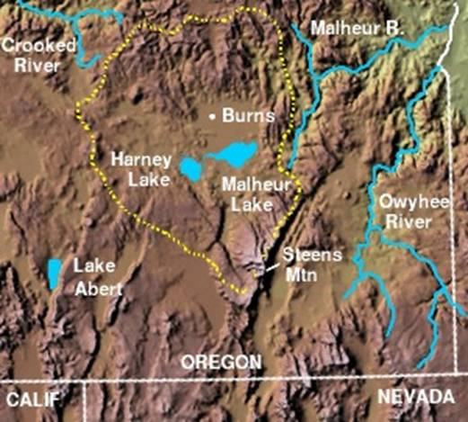
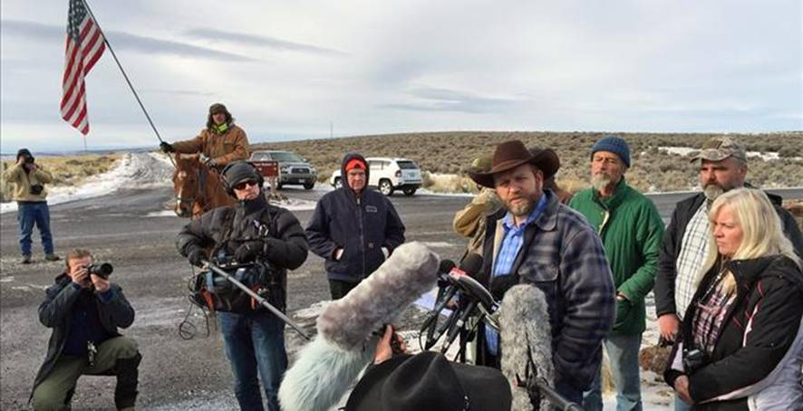
“During the 1970’s the Fish and Wildlife Service (FWS), in conjunction with the Bureau of Land Management (BLM), took a different approach to get the ranchers to sell. Ranchers were told that, “grazing was detrimental to wildlife and must be reduced”. 32 out of 53 permits were revoked and many ranchers were forced to leave. Grazing fees were raised significantly for those who were allowed to remain. Refuge personnel took over the irrigation system claiming it as their own.” Bundy Ranch Blog
Second Standoff –
Bundy’s & Hammond’s vs. The U.S. BLM & FWS
The solution in work is to break up these overreaching barbaric agencies. The next step should be to stop all further transfer of public AND private property into any form of public parks , refuges, etc, without a unanimous direct vote by all affected local private property owners. Locals must take back complete power to save themselves, their land and communities and to stop all land grabs. Elected and unelected government employees are out of touch of property ownership reality and live in an ivory tower. So called “representative” systems never work and this is more proof. We are represented without consent.
Jury acquits leaders of Malheur wildlife refuge standoff
Picture credit to: Paul Driessen - “Life Under an Iron Fist”, article summary and link below

Slide 5
Facts & Events in the Hammond Case -
Critical chronology to understand the historical taking of this private property
Source: http://bundyranch.blogspot.com/2015/11/facts-events-in-hammond-case.html
aa) The Harney Basin (were the Hammond ranch is established) was settled in the 1870’s. The valley was settled by multiple ranchers and was known to have run over 300,000 head of cattle. These ranchers developed a state of the art irrigated system to water the meadows, and it soon became a favorite stopping place for migrating birds on their annual trek north.
a) In 1964 the Hammonds purchased their ranch in the Harney Basin. The purchase included approximately 6000 acres of private property, 4 grazing rights on public land, a small ranch house and 3 water rights. The ranch is around 53 miles South of Burns, Oregon.
a1) By the 1970’s nearly all the ranches adjacent to the Blitzen Valley were purchased by the US Fish and Wildlife Service (FWS) and added to the Malheur National Wildlife Refuge. The refuge covers over 187,000 acres and stretches over 45 miles long and 37 miles wide. The expansion of the refuge grew and surrounds the Hammond’s ranch. Being approached many times by the FWS, the Hammonds refused to sell. Other ranchers also choose not to sell.
a2) During the 1970’s the Fish and Wildlife Service (FWS), in conjunction with the Bureau of Land Management (BLM), took a different approach to get the ranchers to sell. Ranchers were told that, “grazing was detrimental to wildlife and must be reduced”. 32 out of 53 permits were revoked and many ranchers were forced to leave. Grazing fees were raised significantly for those who were allowed to remain. Refuge personnel took over the irrigation system claiming it as their own.

Slide 6
Facts & Events in the Hammond Case
(a3) By 1980 a conflict was well on its way over water allocations on the adjacent privately owned Silvies Plain. The FWS wanted to acquire the ranch lands on the Silvies Plain to add to their already vast holdings. Refuge personnel intentional diverted the water to bypassing the vast meadowlands, directing the water into the rising Malheur Lakes. Within a few short years the surface area of the lakes doubled. Thirty-one ranches on the Silvies plains were flooded. Homes, corrals, barns and graze-land were washed a way and destroyed. The ranchers that once fought to keep the FWS from taking their land, now broke and destroyed, begged the FWS to acquire their useless ranches. In 1989 the waters began to recede and now the once thriving privately owned Silvies pains are a proud part of the Malheur National Wildlife Refuge claimed by the FWS.
(a4) By the 1990’s the Hammonds were one of the very few ranchers that still owned private property adjacent to the refuge. Susie Hammond in an effort to make sense of what was going on began compiling fact about the refuge. In a hidden public record she found a study that was done by the FWS in 1975. The study showed that the “no use” policies of the FWS on the refuge were causing the wildlife to leave the refuge and move to private property. The study showed that the private property adjacent to the Malheur Wildlife Refuge produced 4 times more ducks and geese than the refuge did. It also showed that the migrating birds were 13 times more likely to land on private property than on the refuge. When Susie brought this to the attention of the FWS and refuge personnel, her and her family became the subjects of a long train of abuses and corruptions continued. http://bundyranch.blogspot.com/2015/11/facts-events-in-hammond-case.html

Slide 7
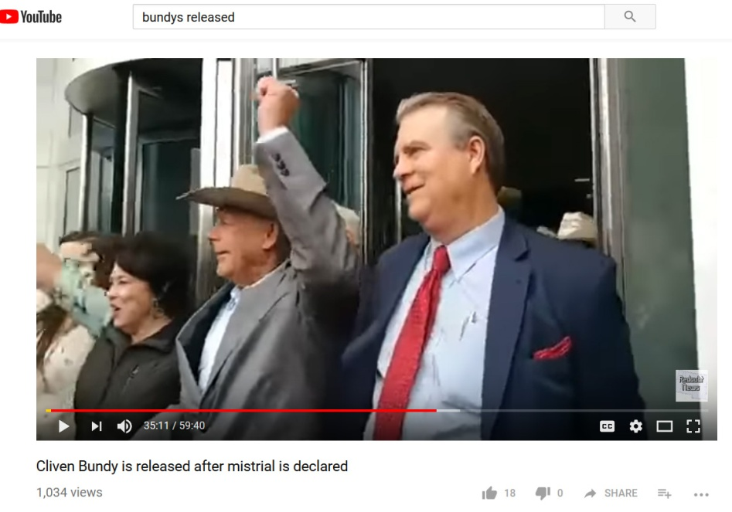
The Bundy Mistrial and Release
“flagrant prosecutorial misconduct”
Judge Gloria Navarro referring to the Bundy family and Montana co-defendant trial.
“Either the government lied or …it’s actions were…so grossly negligent as to be tantamount to lying.” Judge Andrew Napolitano
Click to view – Cleve 35 minutes into video
19 people were charged in the Bundy ranch standoff, 2 men took plea deals, the rest were split into three groups based on charges .
Multiple retrials produced many acquittals and dismissal of conspiracy charges and plea deals on greatly reduced initial charges.
All this, after these men have been in prison for up to a year and half AFTER almost 2 years before they were indicted.
Cleve Bundy had been in jail for 700 days as a “political prisoner”. He was released from prison on January 8, 2018 after refusing to leave until the trail was over to support others waiting trial.
The expectation is the mistrial judgment will have a positive trickle down effect on the remainder of the patriots involved in the standoff.
More background on the Bundy’s and great read by my property rights friend Ron Ewart, subscribe to his weekly newsletter.
    http://www.narlo.org/idarchives/012118.html
U.S. ATG Sessions is launching an investigation of the Nevada office –
  Check this
  More here
”Big federal cases have collapsed in the last 15 years over prosecutors’ failure to share evidence with defendants.” (see above “Check this”.
Cleve Bundy speaks at Freedom & Property gathering Paradise, Montana, thanks Lauralee for forwarding.
Jury Nullification, Judge Navarro just could not handle letting the jurors decide the law – great article on Bundy Blog.

Slide 8
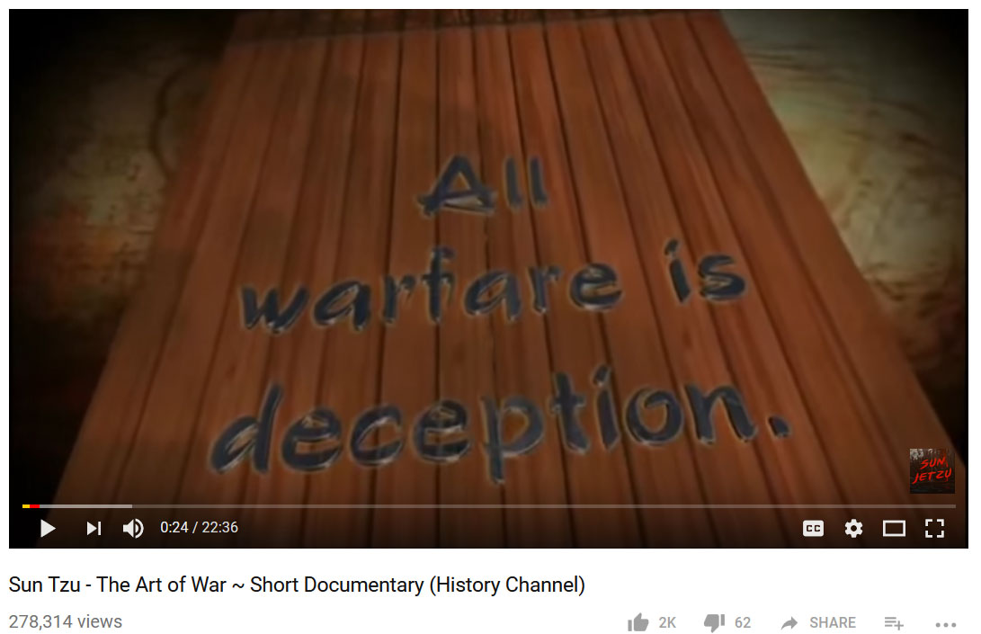
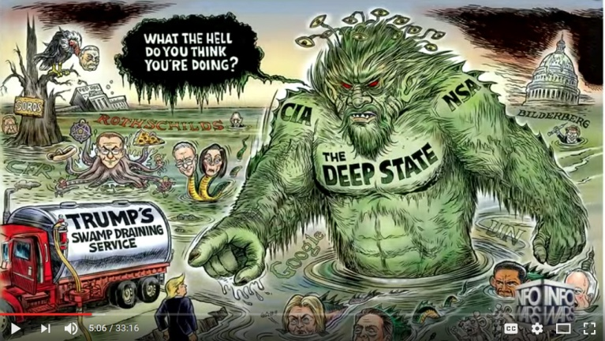
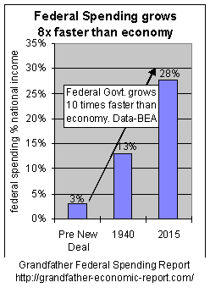
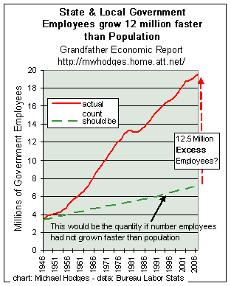
The Art of War by Sun Tzu – Learn to Fight the Deep State
A leader leads by example, not by force.
You have to believe in yourself.
Appear weak when you are strong, and strong when you are weak.
If your enemy is secure at all points, be prepared for him.
If he is in superior strength, evade him.
If your opponent is temperamental, seek to irritate him.
Pretend to be weak, that he may grow arrogant.
If he is taking his ease, give him no rest.
If his forces are united, separate them.
If sovereign and subject are in accord, put division between them.
Attack him where he is unprepared, appear where you are not expected.
The supreme art of war is to subdue the enemy without fighting.
Supreme excellence consists of breaking the enemy's resistance without fighting.
If the mind is willing, the flesh could go on and on without many things.
Victorious warriors win first and then go to war, while defeated warriors go to war first and then seek to win.
To know your Enemy, you must become your Enemy.
Keep your friends close, and your enemies closer.
Read the rest and learn how to fight for your life and rights.
Documentary (History Channel) 22 minutes.

Slide 9
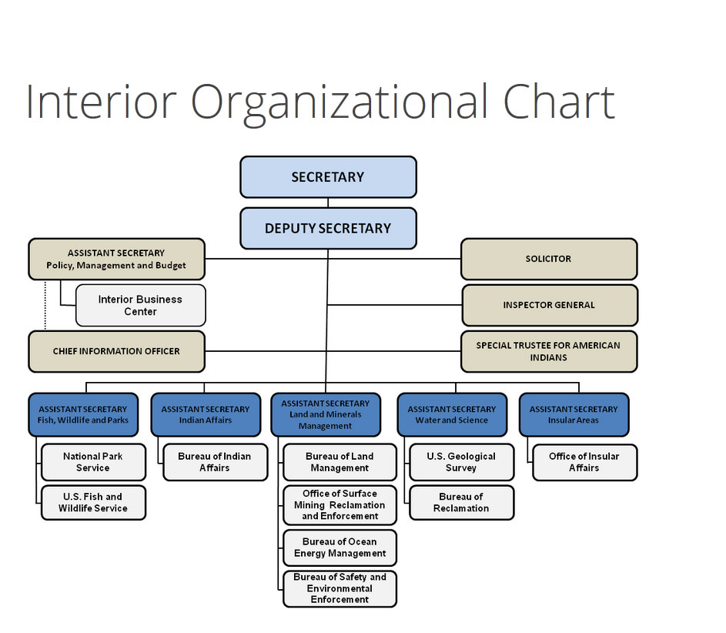

U.S. Department of the Interior - “Protecting America's Great Outdoors and Powering Our Future”
Can you believe this DOI website can be so out of touch to reality. Read these extracted statements . Something is terribly wrong with such blind pious feel good intentions coexisting with the tyranny they create. The DOI & IRS have common ground driven by the same end agenda. “There are none so blind as those who will not see.”
Obviously the Open Government plan is not working even with their 60 some Public Affairs personnel. How can DOI claim to “understand citizens’ demand “ when their heads are full of butterflies, turtles and birds claiming priority over property owners livelihoods and lives?
“The Department of the Interior assembled a multi-functional team from across our department to develop Interior's Open Government Plan. In addition to meeting all of the requirements of the Open Government Directive, Interior's Open Government plan seeks to:
“Create better relationships between government and citizens
Enable DOI to understand citizens' demand for services more clearly and be more responsive to their needs
Increase the rate of innovation by leveraging public knowledge
Increase DOI's ability to meet its mission more effectively and efficiently by transparently engaging the public in decision making
Encourage the development of Open Government Programs
If you have feedback on our Open Government Plan, please send to open@ios.doi.gov.”
If you have feedback to the US DOI email to : feedback@ios.doi.gov
https://www.blm.gov/contact/national-office

Slide 10
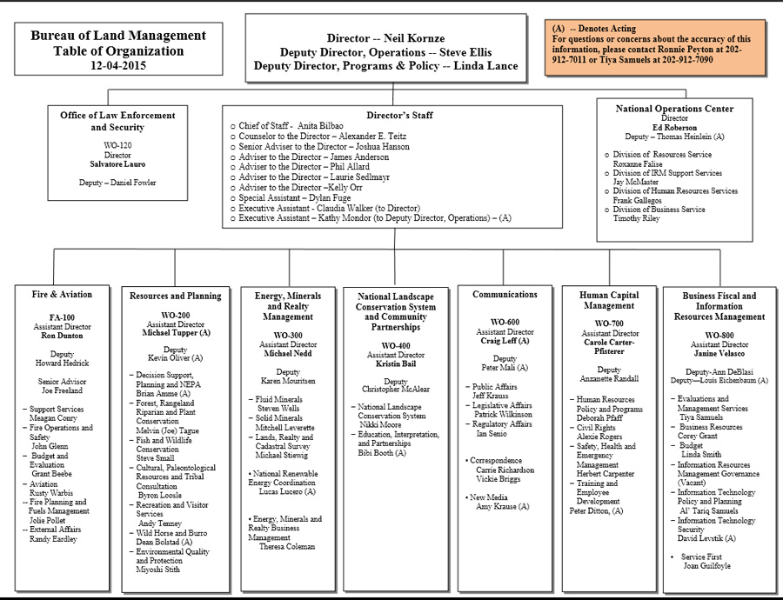
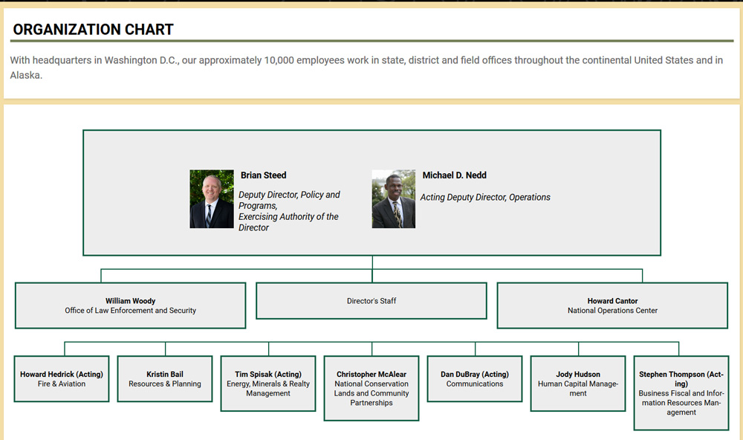
Bureau of Land Management Table of Organization
This Land is MY Land - Neil Kornze - Ex Aid to Senator Reed - Everybody Else Go To Prison.
“Richardson noted that, "Your normal BLM director is a guy who has been in land management for 20-30 years, a grizzled veteran, a career guy. This guy, if he's a career guy of anybody, it's in Senator Harry Reid's office," said Richardson.”
“Politics wasn’t on his mind when Kornze arrived at Whitman: he thought he would major in geology or math, but the breadth of class experiences in his first year turned him on to the social sciences, and he eventually became a politics major.”
Kornze is out thanks to President Trump and US DOI Secretary has named Michael Nedd BLM Director. Lets see if anything changes.
Also three state BLM directors were told to take a hike, i.e. accept transfers, retire or resign
One third of DOI employees are not loyal to Trump.
Trump team may move BLM HDQ to Salt Lake City or Denver.
I would break this green cabal up and scatter it all over the Rocky Mountains and make them live with the ranchers they are messing with, just for starters.
DOI has unlinked this org chart since I put this up hopefully to reorganize
Latest BLM Org Chart as of February2018
Contact National Office Link

Slide 11
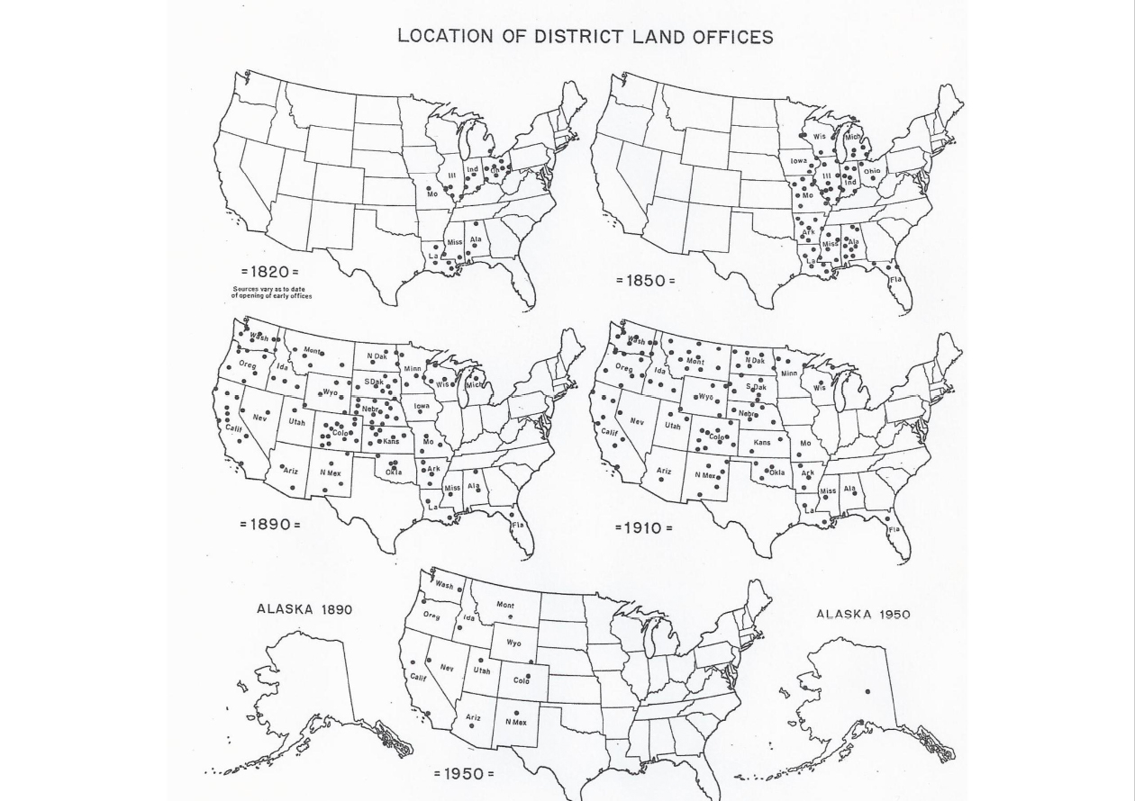
BLM Office Number s – 1820 to 1950
“To see truth, contemplate all phenomena as a lie.”
Thaganapa
"The reality is that the United States of America, which proclaims itself the 'land of freedom,' has the most dishonest, dangerous and crooked legal system of any developed nation. Legal corruption is covering America like a blanket." Dr. Les Sachs, a writer, journalist, and published expert on American corruption now living abroad, wrote in his article Portrait of America's Legal System:
http://www.jail4judges.org/
“No State shall ..pass any…Law Impairing the Obligation of Contract.” - Art. I, Sect. 10
“No person shall..be deprived of life, liberty, or property, without due process of law; nor shall private property be taken for public use, without just compensation.
- Fifth Amendment
“No State shall make or enforce any law which shall abridge the privileges or immunities of citizens of the United States. - Fourteenth Amendment
“ 1000 jobs in the US BLM may disappear in 2018..”

Slide 12
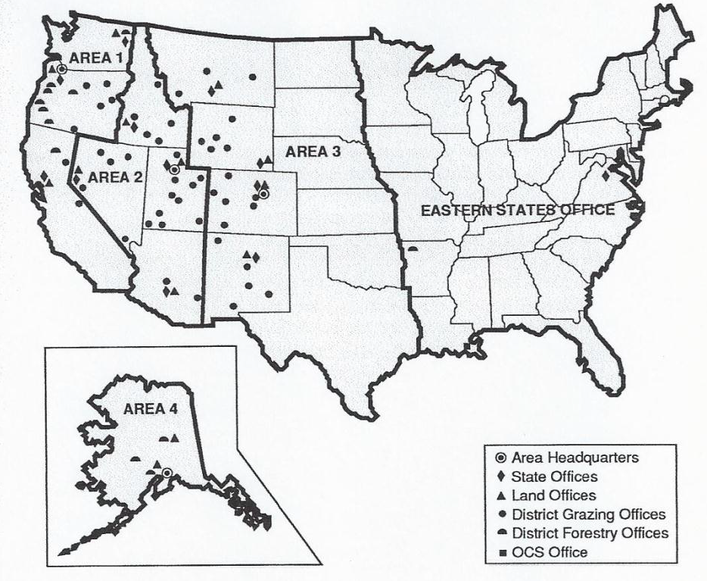
BLM Office Areas 1960
Allie: "Tell me Mr. Cole how long have you been killing people for a living"?
Virgil: " I don't kill people for a living, I enforce the law.“ Appaloosa,
An American Classic 4, Shawn Edward, FOX-TV
"A statute does not trump the Constitution."
People v. Ortiz, (1995) 32 Cal.App.4th at p. 292, fn. 2
Conway v. Pasadena Humane Society (1996) 45 Cal.App.4th 163
UNITED STATES OF AMERICA, v. JERRY ARBERT POOL,C.A. No. 09-10303,
IN THE UNITED STATES COURT OF APPEALS FOR THE NINTH CIRCUIT
(Opinion filed September 14, 2010), On Appeal From The United States District Court For The Eastern
District of California
"It [the federal constitution] must be interpreted in the light of Common Law, the principles and history of which were familiarly known to the framers of the Constitution. The language of the Constitution could not be understood without reference to the Common Law."
U.S. v. Wong Kim. Ark. 169.18S.Ct.456
www.YourRemedyisinTheLaw.com
“”no state shall make or enforce any law which shall abridge the privileges or immunities of citizens of the United State…” 14th Amendment, Sect. 1
The BLM controls 247 million acres
With 8,906 permanent employees
503 based in DeCeit Inc where policy decisions are made
56% of DOI employees are at or within 5 years of retirement.
“As people retire their positions can be shifted to the field”
We must not forget that these are state lands that were to be turned over to the applicable state upon statehood despite what the court rules, the feds have no place on these public lands..

Slide 13
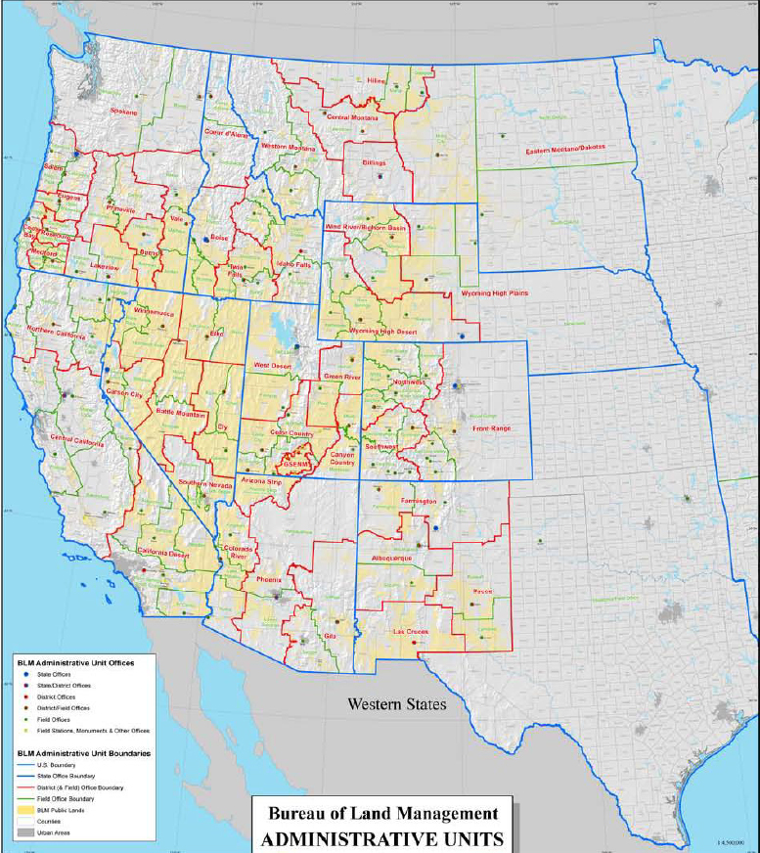
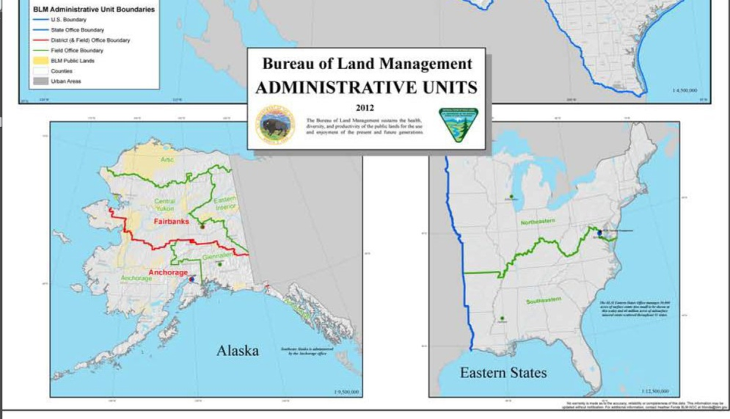
BLM Administrative Units - 2012
“US DOI Secretary Zinke is reorganizing DOI, largest in its history, moving tens of thousands of employees to new locations based on functional operation vs. state boundaries. “
"Sovereign individuals are subject only to a Common Law, whose primary purposes are to protect and defend individual rights, and to prevent anyone, whether public official or private person, from violating the rights of other individuals. Within this scene, Sovereigns are never subject to their own creations, and the constitutional contract is such a creation." To quote the Supreme Court, "No fiction can make a natural born subject." Milvaine v. Coxe's Lessee, 8 U.S. 598 (1808). That is to say, no fiction, be it a corporation, a statute law, or an administrative regulation, can mutate a natural born Sovereign into someone who is subject to his own creations." http://www.supremelaw.org/fedzone11/htm/chaptr11.htm , page 8 of 20
"The enumeration in the Constitution, of certain rights, shall not be construed to deny or disparage others retained by the people." Amendment IX, U.S. Constitution Bill of Rights, i.e. framers recognized other rights that preceded the constitution, rights inherent in Anglo American Common Law and in natural law, i.e. Your Certain Enumerated Unalienable Rights.

Slide 14
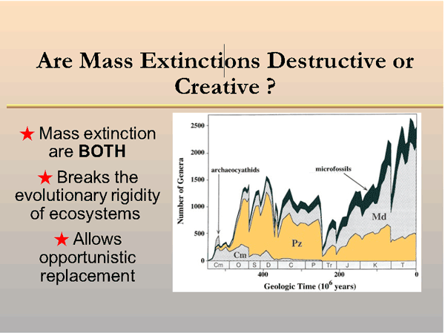
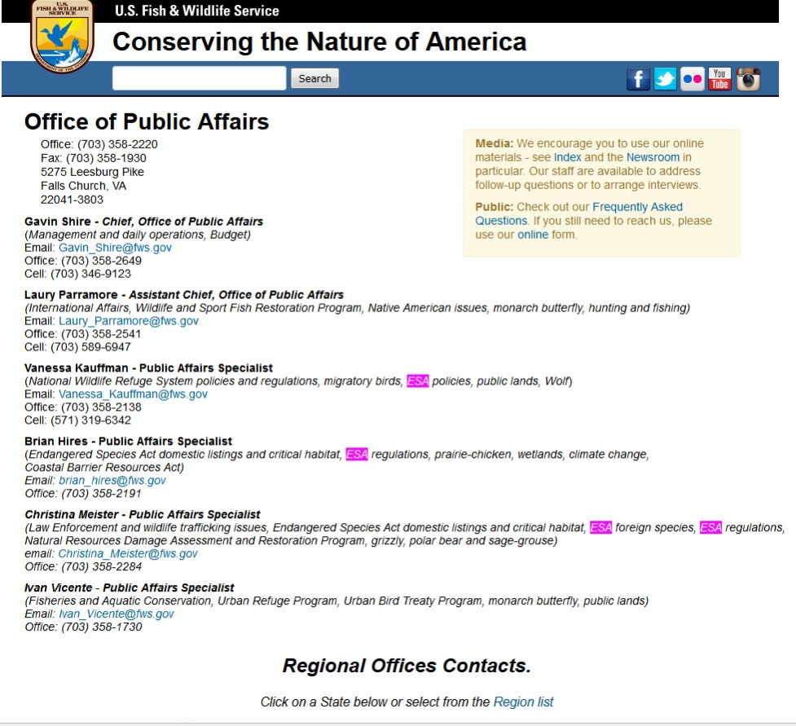
About “Conserving The Nature of America “
At the Cost of Locals and Local Property Owners
Click on slide below for “Freedom From Endangered Species Mythomania “
I count some 57 US FWS Office of Public Affairs positions in 8 regions of America per their web site.
Look at the individual Public Affairs responsibilities.
I see mostly junk green “science” - multiple jobs related to ESA including ESA foreign species, multiple jobs related to monarch butterfly, native American issues, Wildlife Refuge Systems policies and regulations, migratory birds, wolf, prairie chickens, climate change, wetlands, Aquatic conservation, Urban Refuge Program, Urban Bird Treaty.
We have 8,906 U.S. DOI BLM government employees funded by forced tax taking managing species which have mass extinction rate history beyond the control of man living on largely arid land no one wants claiming they also manage the climate while they imprison anyone protesting.
Now check out the upper right chart and web page on “Are Mass Extinctions Destructive or Creative”, they are BOTH.
The US FWS & BLM is a laundering operation for global to local environmental extremism used largely to control private and public land for their own self righteous benefit at the expense of the surrounding property owners.
How can anyone justify government resources on foreign species, monarch butterflies, migratory birds, wolfs, prairie chickens, climate change, aka man caused global warming fiction? Fire prevention OK. Any American, most especially surrounding ranchers who can use this mostly arid land should be given free priority not imprisoned for protesting token fees.
How did such green hobbies become “science” and government careers paid for by forced tax taking on wages, pensions and private property of American state Citizens who do not want this nonsense nor can afford it all while they go to prison protesting!
This is easy to answer; this deception is called Represent Without Consent.
Click to go to Prison For Birds & Turtles

Slide 15
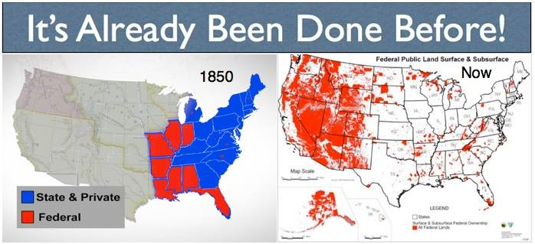
Let’s Get Rid of the Fed -We’ve Done It Before
What is stopping the transfer of federal held lands to the state? And the answer is global to local big money wanting green extreme control.
Environmental extreme groups, especially east coast organizations consider all public lands their play grounds .
Green foundations like The Brainerd Foundation fund radical environmental control over resources in the most beautiful states such as Montana. Link here to see some 300 organizations they are funding across the NW.
Foreign radical foundations such as Wyss Foundations funded by a Swiss billionaire Hansjorg Wyss to better control and transfer large blocks of public land into “national monuments”. Scroll down to “Funding” - https://www.greendecoys.com/decoys/montana-wildlife-federation/
Montana Wildlife Federation is a group funded by many of these extreme liberal green foundations, e.g. Tides Foundations, Cinnabar Foundations, Liz Claiborn Foundation, Tordik Wildlife foundation, Wilburforce Foundation, Henry P Kendall Foundation, Union of Concerned Scientists, Sierra Club of Canada, Earth Island Institute, Wildlands Project/Network. See above link.

Slide 16
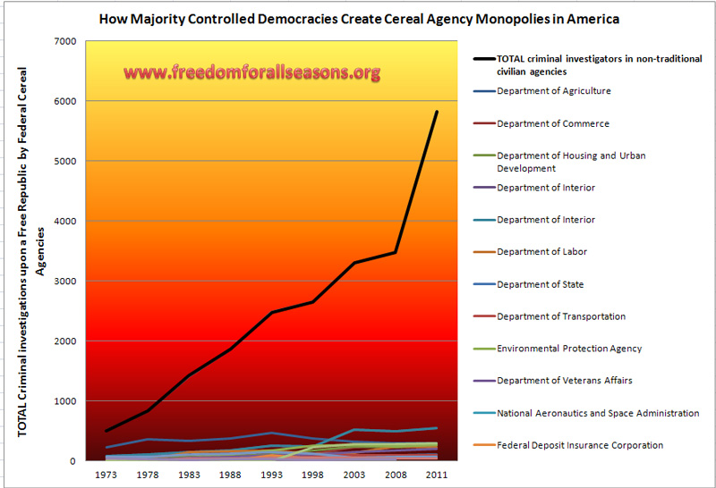
Total Criminal Investigations by Federal Agencies
“When you eventually see through the veils to how things really are, you will keep saying again and again, “This is certainly not like we thought it was.”
Rumi
I use this graph often as it clearly shows the exploding tyranny of the police state in America.
We are living in a epic rise of green extreme serial agencies enforcing insane policies founded in liberal institutions often connected global to local at the federal, state and municipal levels .
Not 80% of these agencies or policies would be allowed if the state Citizen directly voted on each issue.
Total Criminal Investigations Upon a Free Republic by Federal Serial Agencies – Click here for detail table.

Slide 17
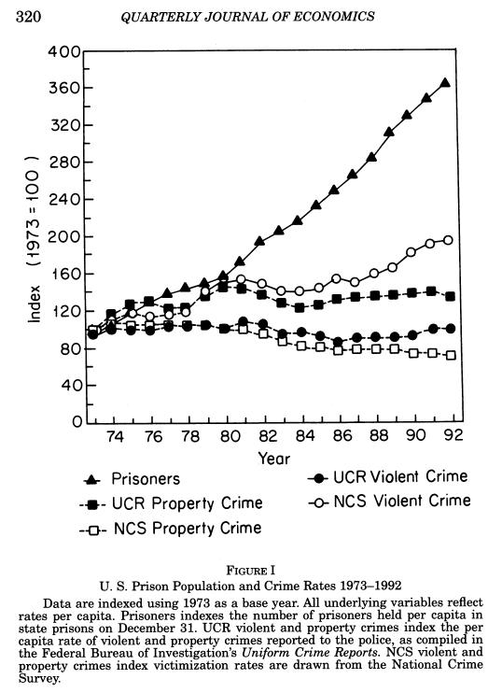
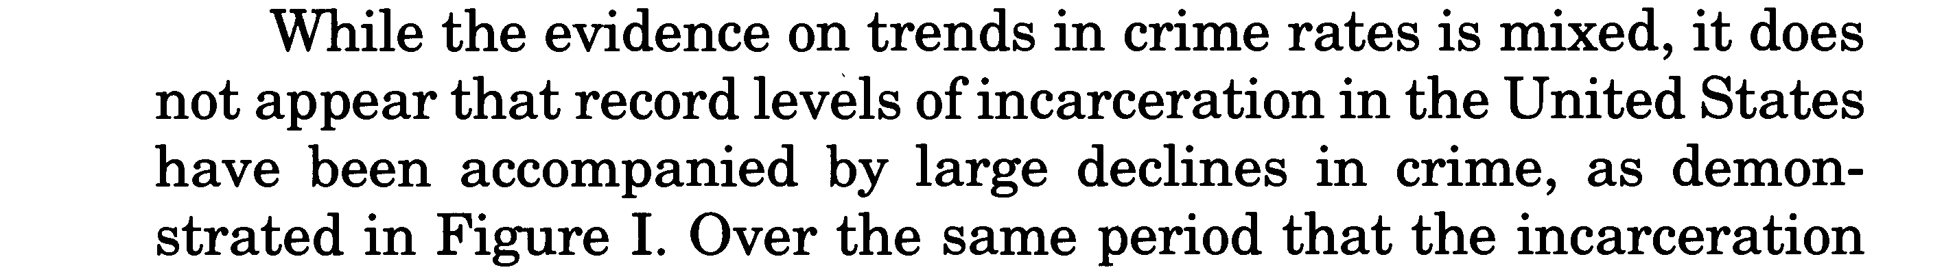
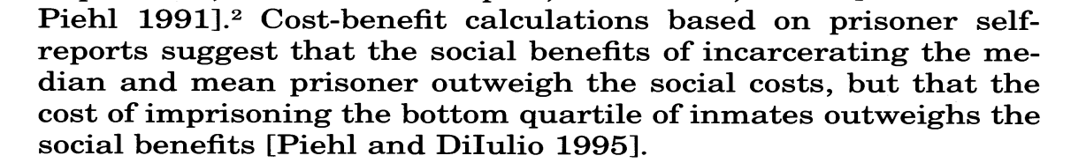
The crime and punishment lie - Part 1 of 2 - More prisoners with no increase in crime
The message on this slide is the social benefits of incarcerating the top 75% of “crimes” does not outweigh the social cost, click on Quarterly Journal of Economics page, directly right.
This is more validation of the message in this presentation, i.e. that at least 75% of the legislation, judication and administration is retrogressive and massively expensive.
Criminal Penalties for Public Corruption/Violations of State Ethics Laws
This brings up the question again, why haven’t the politicians been prosecuted for the real crimes in America of exploiting fallacious fear based knee jerk laws, i.e. “we are the hammer and you are the nail”.
The answer is they have woven themselves a security blanket threaded with their lies. They want quick political fixes that look and feel good which more often make the problem worse.
These lies are often not seen until it is too late, decades, generations, even centuries later.
Codes, regulations, usury & taxes on sovereign state Citizens do not work. Punishment of a non consenting adult, especially for a non violent “crime” is regressive & costs more than the return to society.
"The U.S. incarcerates nearly 2.4 million people,¹³ including people held pretrial and those sentenced for an offense; if they were all in one state, it would be the 36th most populated, between New Mexico and Nevada. No other country in the world incarcerates as many people as the United States. China, a country of 1.3 billion people—is second, incarcerating 1.6 million people.¹⁶ http://drugwarfacts.org/cms/?q=node/62
Prisoners
Crime

Slide 18
The crime and punishment lie - Part 2 of 2 (one small example )
This slide is added to show how grand jury power has been greatly eroded by government prosecutors and state ATGs. All power should rightfully rest with the state Citizens through jury nullification of the laws, grand juries and direct vote on ALL municipal, state and federal legislation. This never happens and government agency power is out of control. FreedomForAllSeasons
THE GRAND JURY DUE-PROCESS RIP-OFF ~
SPEAKER: Tony Davis
We were told a few years ago through a former federal prosecutor that if you wanted to win your case you need to follow the grand jury.
He also advised that in many cases the grand jury does not actually meet. He said the prosecutor has the foreman of the grand jury’s signature stamp right there in his office and fills out the grand jury form himself. The prosecutor then simply just stamps the signature; similar to robo-signing on a mortgage.
We tested the concept in a case in Wisconsin in which the person had pled guilty and spent 8 years in prison.
They offered him an expungement……..
In the last 2 weeks we tested the concept in a federal case in Louisiana. The clerk said the prosecutor held all the grand jury records. The prosecutor said these records had been destroyed. Furthermore, the prosecutor said only one person testified at trial, an IRS agent, but 30 people testified at trial. We then checked and found the IRS agent had used a fake name at trial.
We thought Title 18 was hot (it still is) and CIPA and Rovario and Brady were hot. (They still are).
We have never seen anything as hot as this.
As just mentioned, in a recent case in federal court in Louisiana, the clerks admitted they had none of the grand jury records. So who holds them? According to the clerks, it is the prosecutors.
But isn’t that a violation of US v. Williams, 1992, SCt, in which Scalia stated that the grand jury is to be a 4th Branch of government, not to be tampered with by any other branch.
And we started investigating grand jury records in other cases.
What we found was:
  Robo-signing (similar to a mortgage) on the grand jury records;
  Destruction of records to avoid having them inspected;
  No recorded vote of grand jury members (at least a quorum must vote for indictment but how do you know if no record exists;
  No presentation of the indictment in "open court"
  The prosecutor acts as a witness, which is completely illegal.
  Subliminal messaging to grand jury (and to regular jury) by prosecutor.
As we said, the grand jury is a bigger issue than even Title
For more information and for a copy of the lawsuit…
Contact: Martin Michaelsson: MM@YourRemedyIsInTheLaw.com
Brought to you by....
www.AmericansRestoringAmerica.com

Slide 19
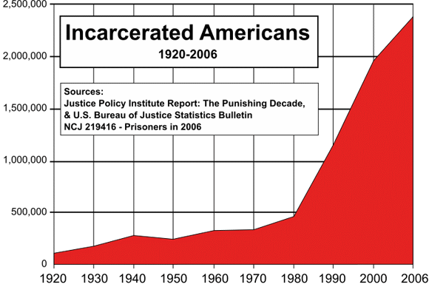
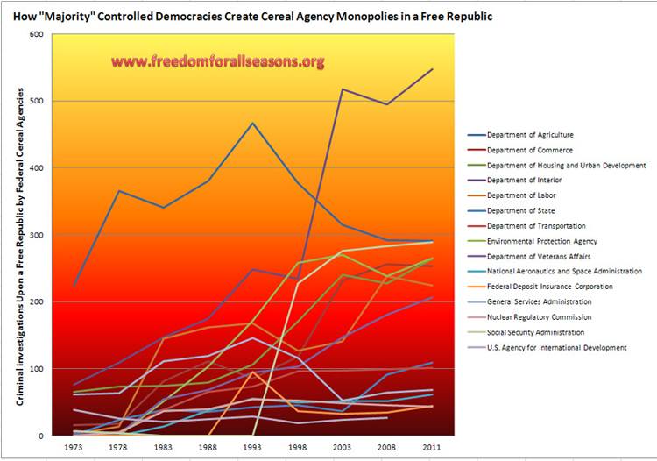
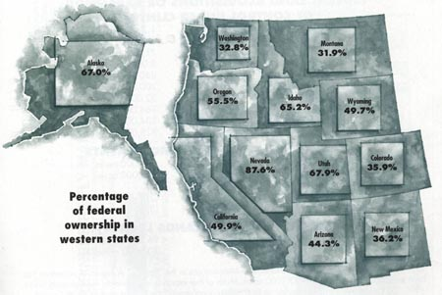
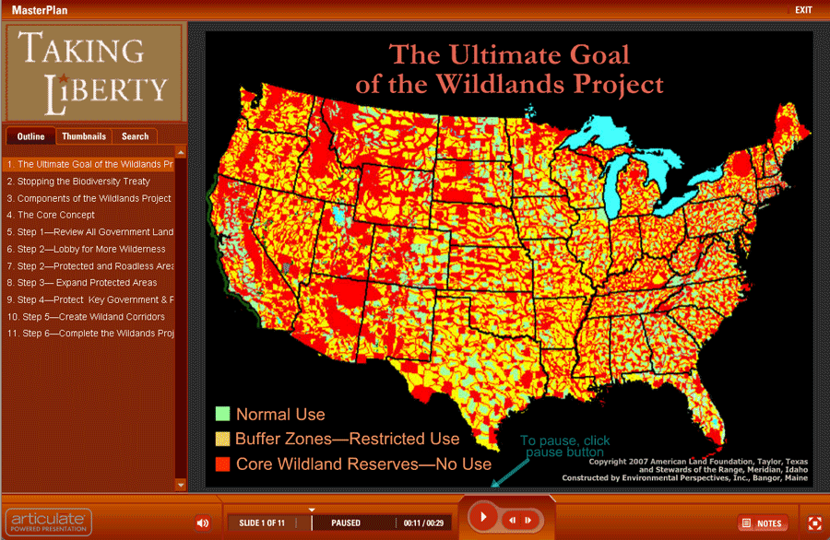
How free Republic states Are taken
Victimless Crime Constitutes 86% of Federal Prison Population
The blocking of jury nullification and Grand juries by the federal, state and municipal judiciary has led to this overwhelming abuse of serial agency use of force.
Some half of federal prison population are illegal aliens.
American priorities are upside down and backwards, i.e. no border control plus green serial agencies driven by green extreme to imprison ranchers and their cattle over turtles = government tyranny!

Slide 20
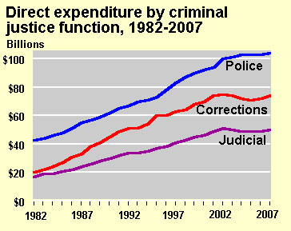
“America is a nation of laws” lie – how natural acts are criminalized for profit & power
“When you get free from certain fixed concepts of the way the world is, you find it is far more subtle, and far more miraculous, than you thought it was.
Alan Watts
“Law. That which is laid down, ordained, or established. A rule or method according to which phenomena or actions co-exist or follow each other. Law, in its generic sense, is a body of rules of action or conduct prescribed by controlling authority, and having blinding legal force. United States Fidelity and Guaranty Co. v. Guenther, 281 U.S. 34, 50 S.Ct. 165, 74 L.Ed. 683. that which must be obeyed and followed by citizens subject to sanctions or legal consequences is a law. Law is a solemn expression of the will of the supreme power of the State. Calif. Civil Code, para. 22.1.”
Black’s Law dictionary, Fifth Edition
FreedomForAllSeasons Note: “controlling authority” is the Grand Jury AND Trial Jury and Nullification and direct vote of all government policy in a true and honest Republic.
Man made “laws” grow and change to suit the politics.
Unalienable rights are birth rights freely given to the American natural born and rightfully naturalized Citizens . These rights are inviolable, immutable and absolute.
Notice the above legal definition of law capitalizes the “S” in state and not the “C” in Citizen, this is backwards, i.e. the Citizen is sovereign not the state in a true and honest republic.
Notice the over use of threatening verbiage such as “ordained”, “controlling authority”, “having blinding legal force”, “must be obeyed by the citizens subject”. This power was never given, it was self bestowed by politicians, lawyers and benefiting non government organizations.
America is a nation foremost of rights NOT laws.
These rights are described in the Laws of Nature and Nature’s God, the Declaration of Independence, the Bills of Rights and the spirit and intent of the success of the first American Revolution.
These Certain Enumerated Unalienable Rights (70 ) are codified together for the first time by Freedom For All Seasons here: http://www.freedomforallseasons.org/NaturalLawAndRightsReports/YOUR%20CERTAIN%20ENUMERATED%20UNALIENABLE%20RIGHTS%20(Revision%2011).pdf

Slide 21
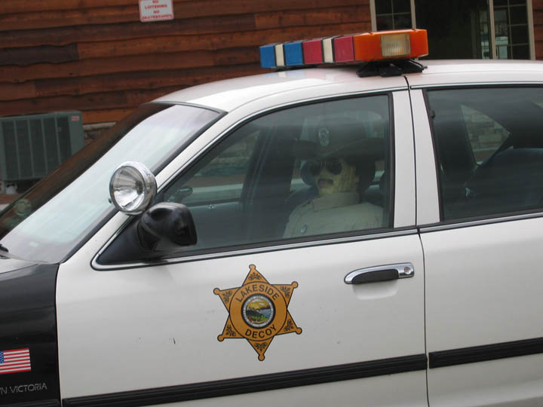
Few Sheriffs stand tall – part 1 of 2 Separating the lies from the truth
Larceny. In criminal law. The wrongful and fraudulent taking and carrying away by one person of the mere personal goods of another from any place, with a felonious intent to convert them to his (the taker's) use, and make them his property, without the consent of the owner. Blacks Law Dictionary 1910, 2nd Edition
Sheriffs Stand TALL for the Constitution -
Eight county sheriffs from Northern CA and Southern OR speaking on a panel at the Defend Rural America Land seizures October 22, 2011 in Yreka. http://www.youtube.com/watch?v=e4RuWK2Ww-4
There are 3141 counties in America, eight with balls.
We need about 0.5 % to 1% for critical mass and change,
i.e. 31 Sheriffs = 1% of 3141 counties) to stand up & throw out ALL GLOBAL TO LOCAL government serial taking agencies & their NGO’s.
Border Collapse And What The NRA and Local Sheriffs Have To Say
http://politicalvelcraft.org/2011/11/14/u-s-sheriffs-rise-up-against-federal-government-sheriff-threatens-feds-with-swat-team/
Nevada Sheriff Tony DeMeo Stops Federal Government: Feds Engaging In Illegal Confiscation Of Cattle And Water Rights Of County Property Owner.
Oregon Sheriff Gil Gilbertson Gives Federal Agents The Boot: Feds Have No Jurisdiction!
Obama’s Federal Stooges Beginning To Understand The Power Of Sheriffs: Sheriff Warns Federal Agents They Will Be Arrested If They Interfere!
Arizona Sheriff: ‘If Decapitating Police Officers Is Not Terrorism, What is?’: More Troops At Korean Border Than Deadly U.S. Mexican Border.
How you can support the County Sheriff Project:
  Visit their Website at http://CountySheriffProject.org
  Share this video to your social networks and email lists.
  Give your local Sheriff a copy of Sheriff Mack's book "The County Sheriff: America's Last Hope" available at http://SheriffMack.com, and tell them about the County Sheriff Project.
“Here it is in a nutshell. The IRS is a private, debt collection agency for the private banking system known as the Federal Reserve Bank. The IRS is not a government agency. I repeat, the IRS is not a government agency. Never has been, never will be.
The IRS is formerly the Bureau of Internal Revenue (BIR) situated in and with authority only in the Philippine Islands (Trust Fund # 61), and moved into Puerto Rico (Trust Fund # 62). In the 1950’s, with the stroke of the pen, the BIR was transformed into the current notorious IRS and brought onto the 50 united States. This was done without any Congressional authority whatsoever. There is no Congressional authority for the IRS to exist and operate in the 50 states recorded anywhere in any law-books. Again, keep in mind, that the IRS is the “Private, debt collection agency for the private banking system known as the Federal Reserve Banks.”
Due to the abysmal ignorance of the American people, most Americans do not realize that there are two title 26.”
Rico For Sheriff
http://ricoforsheriff.com/irs-liens-and-levys
Read candidate Rico for Sheriff campaign speech - http://ricoforsheriff.com/irs-liens-and-levys/196

Slide 22
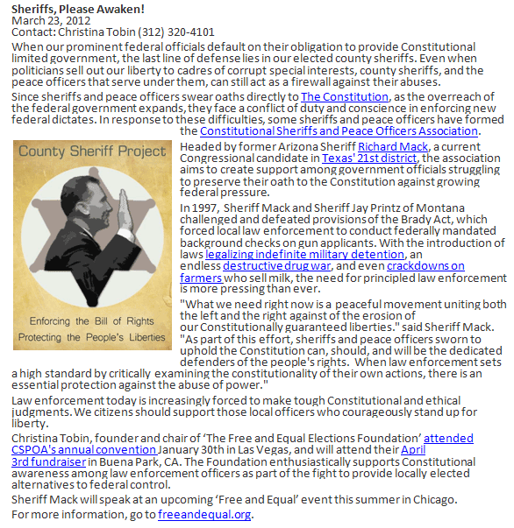
Few sheriffs stand tall – part 2 of 2
Sheriffs are they going to wake up
"Any law which would place the keeping and safe conduct of another in the hands of even a conservator of the peace, unless for some breach of the peace committed in his presence, or upon suspicion of felony, would be most oppressive and unjust, and destroy all the rights which our Constitution guarantees." Pinkerton v Verberg, 78 Mich 573, 584; 44 NW 579, 582-583 (1889).
Access to letter at left with links hot
13 Things the Government does not want your to know (written by a Canadian Freedom Fighter)
TO TRAVEL IS A "RIGHT,“ NOT A GOVERNMENT GRANTED "PRIVILEGE "
Much More Freedoms to Find The Way OUT From De Facto Laws

Slide 23
Sheriff Mack on the Oregon Standoff and What the Media Isn’t Reporting
Listen to Sheriff Mack support the Hammond and Bundy Ranch Families - http://truthinmedia.com/exclusive-sheriff-mack-oregon-standoff-hammond/
“The Crisis of the Day When I sued the Clinton administration in 1994, I never imagined that Justice Scalia - the author of the ruling for the majority - would be so profound and powerful with his defense of the Tenth Amendment(1). Not only did Scalia say that the "States are not subject to federal direction" and that the US Congress only had "discreet and enumerated powers" and that federal impotency was "rendered express" by the Tenth Amendment, he also proclaimed that the States "retained an inviolable sovereignty." You would think that these statements alone would be monumental enough and would provide sufficient ammunition for all state and local officials to stand against any governmental tyranny without any hesitation. Nevertheless, Scalia went even further in this landmark decision, one in which two small-town sheriffs headed the Feds "off at the pass" and sent them on their way. Scalia, in his infinite obligation to the Constitution, took this entire ruling to the tenth power when he said, "The Constitution protects us from our own best intentions...so that we may resist the temptation to concentrate power in one location as an expedient solution to the crisis of the day." The "crisis of the day?" Was Scalia clairvoyant? He rendered this opinion in June of 1997.”
Note (1) Tenth Amendment – “The powers not delegated to the United States by the Constitution, nor prohibited by it to the States, are reserved to the States respectively or to the people. “

Slide 24
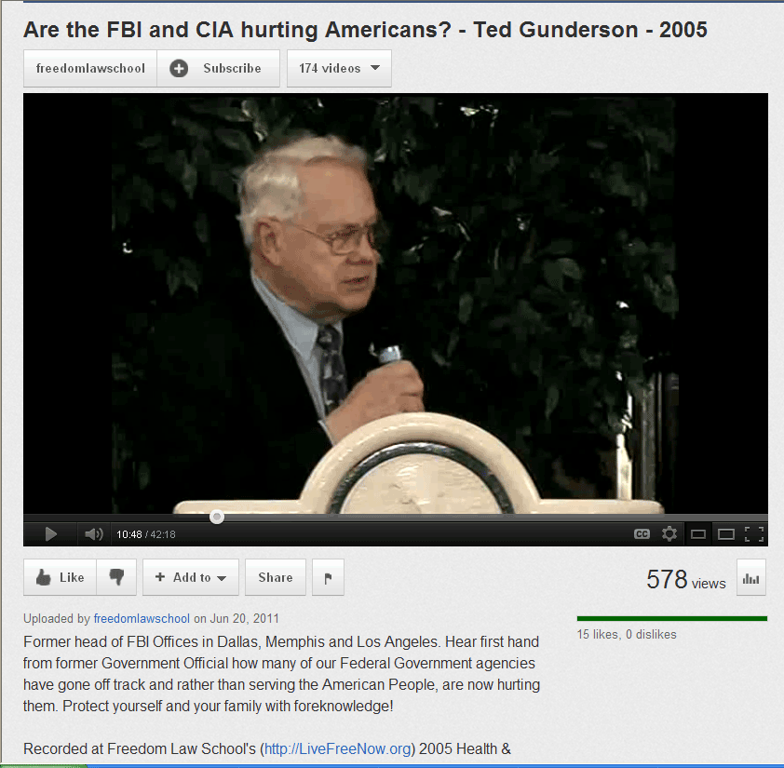
More Federal serial Agency Corruption -Former head of fbi offices blows the whistle on the fbi and cia
“Fear is the greatest of all foes. It is a devil residing within. Fearlessness is the first rung on the ladder of freedom.”
“Living with the Himalayan Masters”, Swami Rama
Click on YouTube Video Below
A Nation Betrayed - A 10 Page Summary By Carol Rutz
Carol Rutz' incredible journey from mind control victim to freedom is both harrowing and deeply inspiring. Her thorough research supporting her personal experience provides clear evidence of deeply hidden agendas within a shadow government. She explains how to order the thousands of pages of released government documents upon which much of her research is based at the end of this document. Help create a better world
    http://www.wanttoknow.info/nationbetrayed10pg
Mind Control Cover-up The Secrets of Mind Control
    http://www.wanttoknow.info/mindcontrol
US: Secret Service agents and members of the military are exposed for throwing a drunken party and bringing 20 prostitutes to their hotel. This was while working in Colombia to protect President Obama. CBS 2012 Apr 17
“The Rape of the Mind by A.M. Meerloo, M.D.
The Ted Gunderson Files - http://educate-yourself.org/tg/
“Former head of FBI Offices in Dallas, Memphis and Los Angeles . Hear first hand from former Government official how many of our Federal Government agencies have gone off track and rather than serving the American People are hurting them. Protect yourself and your family with foreknowledge!”

Slide 25

Airline Captain, navy pilot & federal airline safety inspector/investigator blows the whistle on the cia and other serial agencies
“Eventually justices of the U.S. Supreme Court became implicated as they were officially notified of the civil rights violations and obstruction of justice by judges over whom they had supervisory responsibilities.
The evidence strongly indicates that a powerful force somewhere high in government was responsible for the original scheme, which had the power to control the corrupt acts of large numbers of California and federal judges.”
Captain Rodney Stich background:
A Navy pilot during World War II.
Airline captain for many years, including flying captain for Japan Airlines…
Flying wounded GIs to the United States from the Korean War.
Flying Muslim pilgrims from throughout Middle East to the holy cities of Mecca & Media.
In Iran the morning that the CIA orchestrated the revolution..
Captain of virtually every propeller aircraft flown by airlines after WW II ..
Federal airline safety inspector-investigator, given the assignment to correct the conditions that at that time were responsible for worst series of airline disasters in nation's history.
A successful real estate developer and investor, pyramiding a $500 investment into $10 million by the time corrupt judges.
Author of 19 books on government intrigue.
Guest and expert on over 3,000 radio and TV shows since 1978.
Confidant to several dozen other former government agents, former drug smugglers working covert government operations & former Mafia sources.
Activist since 1964, aggressively fighting a one-man battle against the endemic corruption in government.
The target of continuing legal, judicial and Department of Justice attacks since 1982. The results and obviously the goal of the multiple schemes, was to halt his costly attempts to circumvent the endemic cover-ups and inform the American of the corrupt activities and tragic consequences adversely affecting the American people and the United States.
The parallel attacks included over 50 lawyers and law firms, over 50 federal judges, over a dozen California judges, all engaged in massive civil rights combined with repeated violations of multiple criminal statutes, including obstruction of justice; felony retaliation against a witness and former federal agent; criminal violations of civil rights that were part of the obstruction of justice schemes.
The attacks by these dozens of people knowingly hindered−and surely intended−the ability to continue to expose the high level corruption. That in turn not only protected the corrupt activities responsible for numerous great tragedies, but insured that the corruption and the tragedies would continue. In this way, all of the participants became complicit, and enablers, to some of the worst tragedies to affect the United States and its people. (Details in such documentary books as Unfriendly Skies: 20th & 21st Centuries; Defrauding America; America's Housing and Financial Frauds, and others.
Among the reasons why most Americans are uninformed of these matters is due to such matters as:
Culture of cover-up by bribe-taking members of Congress.
Culture of cover-up by employees in control of the political U.S. Department of Justice.
Culture of cover-up by media people and media corporations in the United States.
Americans, who are either (a) unable to comprehend these matters; (b) those who are too lazy to read anything except mundane trivia matters; (c) those who lack the courage and integrity to show outrage and take action.
Another way to look at the decades of lying to the American people and the repeated infliction of great harm affecting them is to think of the public as a "feeding trough" for special interests to feed upon. http://www.defraudingamerica.com/introduction.html

Slide 26
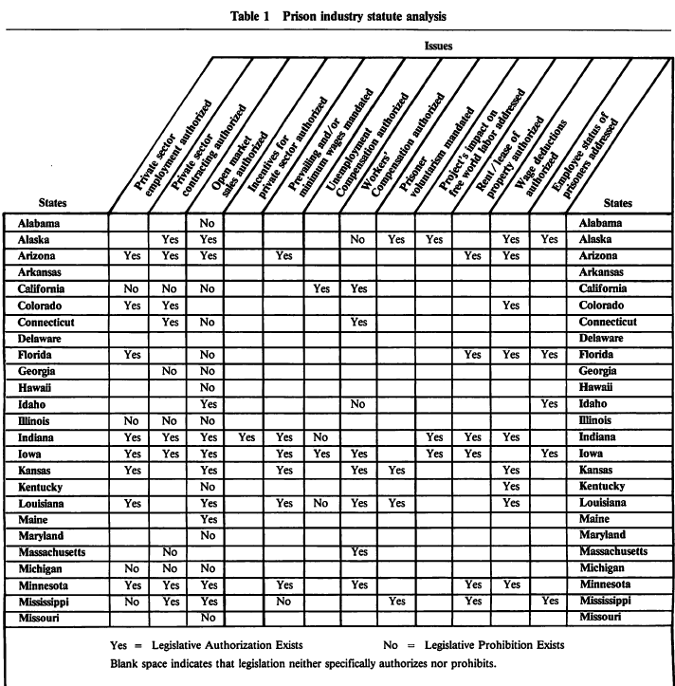
How the states fund their lies –
States funding prisoner Unemployment & Workers compensation
“Those who trade liberty for Security have neither.”
John Adams
Click on the table to the left to read the study regarding how all the states treat Unemployment and Workers compensation, et al.
3 states fund Workers Compensation in prison.
20 states fund Unemployment Compensation in prison.
12 states mandate paying prisoners the prevailing or minimum wage if they work.
It seems an American convicted of a state “crime” may be better taken care of in prison than out.
This is another social funding absurdity that must be stopped.
The states have turned prisons into social clubs and political subdivisions into prisons .
Worker’s Comp. Fraud - http://video.foxnews.com/v/1688467862001/workers-comp-fraud-on-the-rise/
This is another reason why the Feds and the States are quick to pull their triggers to put any Sovereign state Citizen in prison.

Slide 27
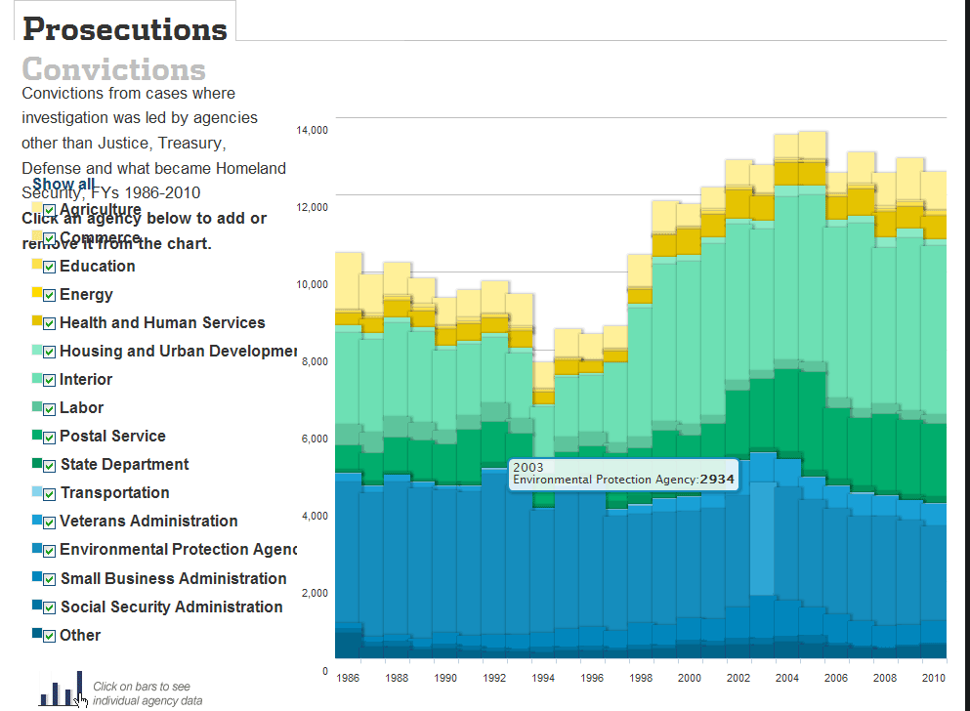
The Regulation lie - part 1 of 4
“Until We Are All Free, We Are None Free “
Frederick Douglass
Highest Prosecutions
  Dept. of Interior, e.g. BLM
  EPA
  Postal Service
The core crimes to freedom, liberty and individual unalienable rights are taking of private property by mandatory regulations, taxes and usury/debt.
This chart represent the epitome of de facto force and why centralized power corrupts absolutely.
The federal government which has no authority or jurisdiction outside of its own Federal Zone.
These are predatory serial agencies that would never be allowed in a true and honest republic let alone have authority or jurisdiction over states & state Citizens.
No matter how beneficial you believe these agencies may be, they are far more destructive and corrupt. They are like an aggressive form of cancer.
The federal agencies must be broken up and scattered to the wind
Federal Police Ranks Swell to Enforce a Widening Array of “Criminal” Laws
Links to this WSJ article have been broken, cannot find article or data.
Dept. of Interior
USPS
EPA

Slide 28
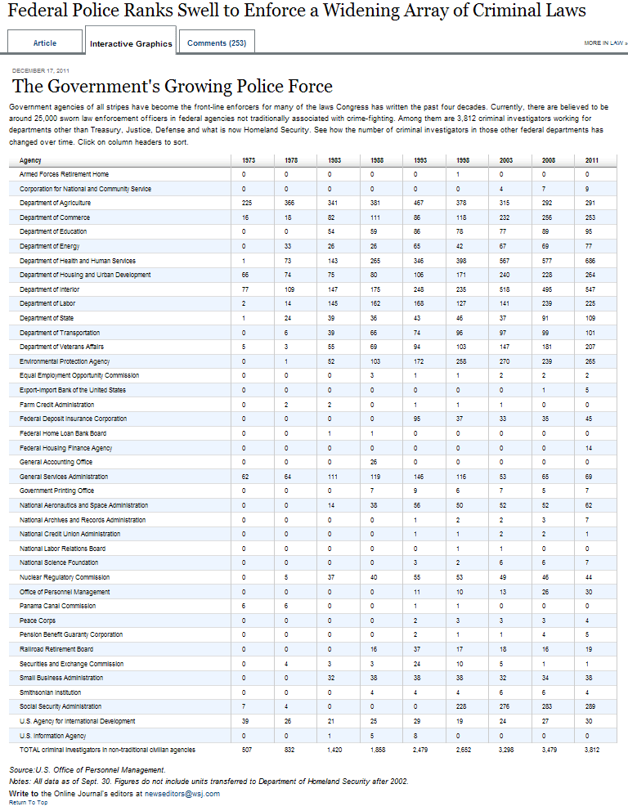
The Regulation Lie – Part 2 0f 4
Double click table to the right for a full screen view
In slides 1 thru 3 of The Regulation Lie, notice the explosion of government agencies using force and violence to enforce legal fiction non violent fictional infractions.
This growing web of regulatory lies are created by an exponential and quantum increase in planning, legal and tyranny staff.
In turn, this avalanche of government agency force and violence combined with growing serial agencies, lawyers, police and billions of dollars wasted overhead paid by forced taxes, usury & nonsense regulatory compliance fees, collapse the private sector and the civilization.
This is a global to local orchestrated agenda by the globalist and their pawns of central banks, politicians, government municipal corporations, tax free foundations, multinational corporations, BAR associations , academia, education, mainstream media which produce nothing of value.
The bottom line is none of this is necessary nor legitimate and can be easily replaced by a limited Free Republic system of public coops and free competing enterprises based entirely on free choice using a 1X.X% digit tax on corporations ONLY.
This table gives the regulatory profile of an intentional global to local centralized, highly elite organized crime ring.
The greatest con of all is that a free Republic can be regulated by force, violence and tyranny, this is extremely evil and sick thinking, a.k.a. planning.
Slide 28

Slide 29
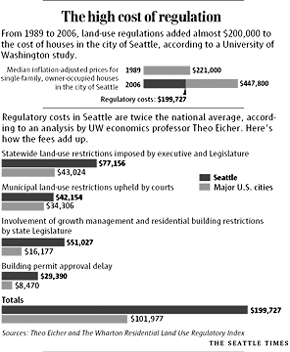
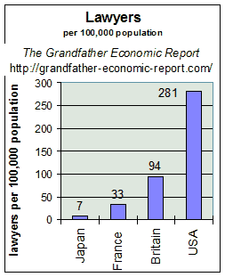
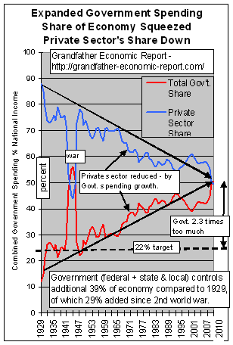
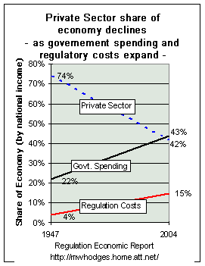
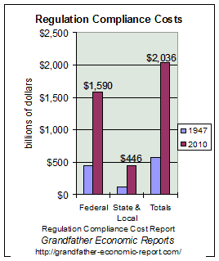
The Regulation lie - part 3 of 4
The price of forced unwanted regulation in free republics is economic and human suicide. These graphs are more proof you cannot force free and sovereign state Citizens or their family businesses to comply with compulsory government regulation.
Slide 29

Slide 30
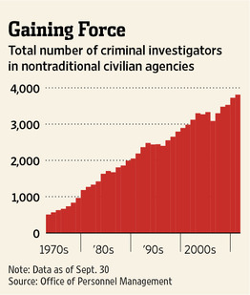
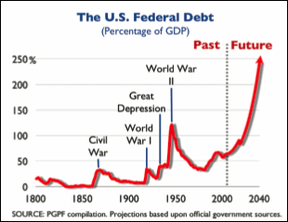
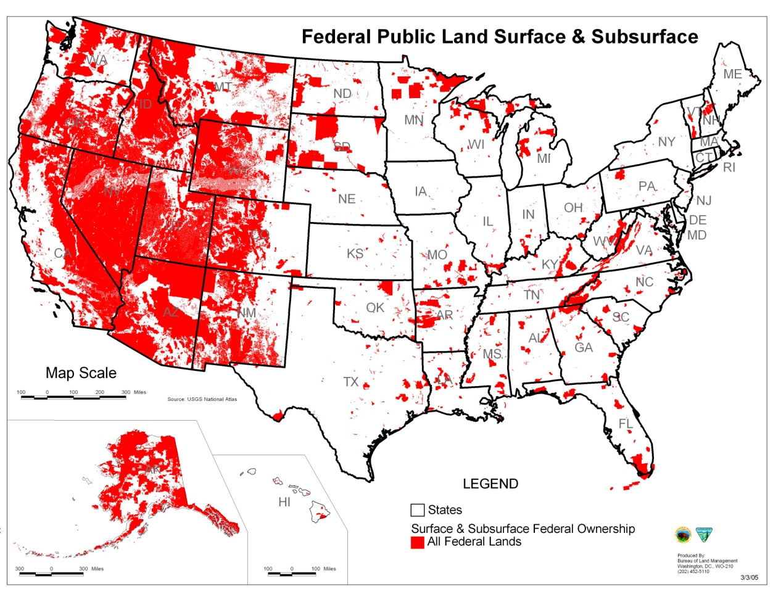
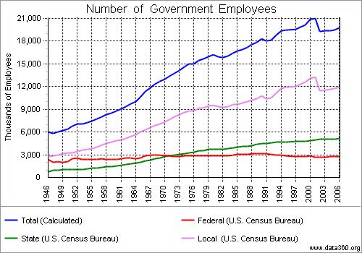
Bloated government serial agencies + regulations = exploding Investigations & incarceration - Part 4 of 4

Slide 31
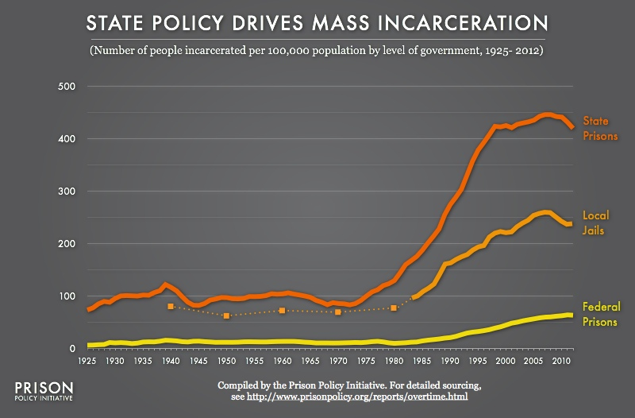
Jury Nullification – Why Aren’t Jurors Informed
Jury Nullification – Why the Legislature and PA’s do Not Want It
The Citizens Rule Book, Jury Nullification
New Hampshire Adopts Jury Nullification Law
New Hampshire Guts Jury Nullification
Nevada U.S. Judge and how she got away with not allowing Jury Nullification – Must Read
https://www.youtube.com/watch?v=3XnVqSNV3Aw
"The "justice" system is just a tool for the powerful to control the population. Those that have political power are not prosecuted for real crimes but ordinary people are put in a cage for what? For disobeying the State. Judges and prosecutors are now attempting to force jury's into rubber stamping convictions. The message is clear: "shut up and obey". This country is no longer slipping into tyranny. We are deep into it." Anonymous

Slide 32
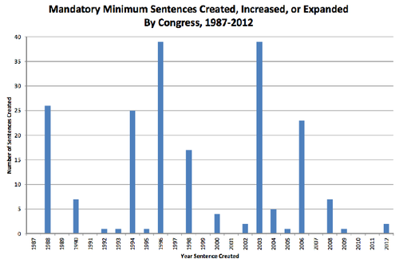
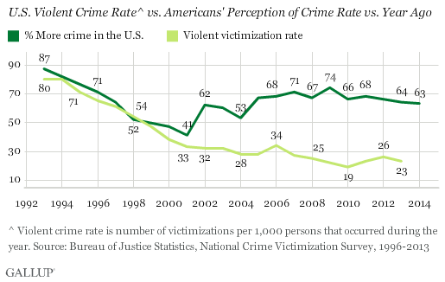
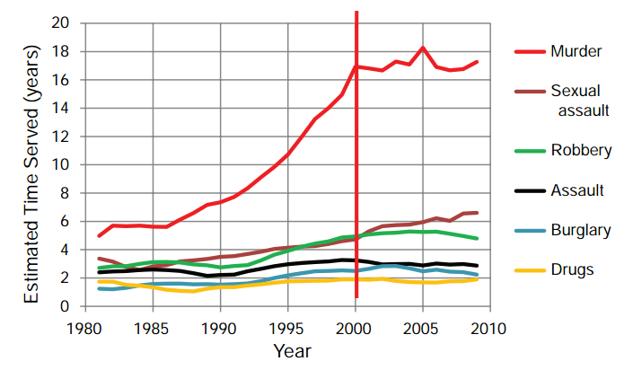
Mandatory minimum sentences
I. What this Graph Depicts
This graph depicts the number of times federal mandatory minimum sentences were created, increased, or expanded by Congress each year between 1987 and 2012. As of August 2012, there were 201 such new sentences or increases or expansions of existing sentences.
II. CONCLUSIONS FROM THE DATA
Congress is significantly more likely to create or expand a mandatory minimum sentence in an election year than in a nonelection year. Since 1987, there has been only one election year (2010) in which Congress did not create or expand any mandatory minimum sentences.
Crime rate is dropping but people do not believe it

Slide 33
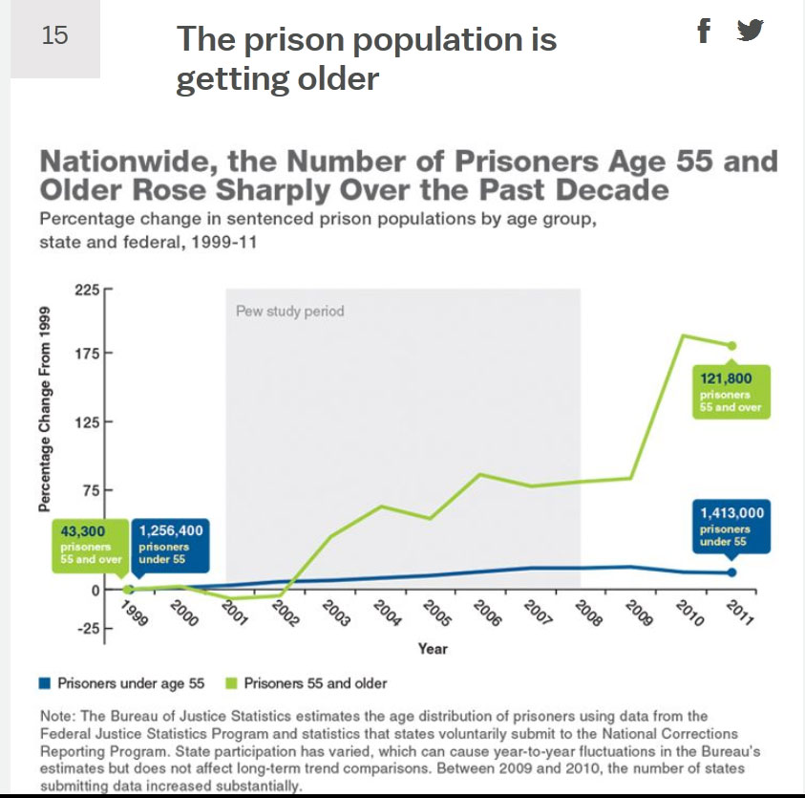



Mass Incarcerations- Part 1 – Prosecute First - Think Later
Incarceration continued to rise after crime fell

Slide 34



Mass Incarceration s – Part 2 -
The 5 Keys to Tyranny
Indoctrination
Regulation
Taxation
Incarceration
Repeat
States with less incarceration DO NOT have more crime

Slide 35

Sentencing Terrorist Crimes
Sentencing Terrorist Crimes
Ohio State Law Journal
VI. CONCLUSION
“Where sentencing in cases involving politically motivated violence was
once straightforward, since violence was at the root of a criminal conviction, the modern terrorism prosecution now relies largely on material support charges unconnected to any violence and inchoate criminal activity not likely to result in
actual violence. The passage of a terrorism-sentencing enhancement reflects the government’s resolve to increase penalties for a certain class of offenses.”
Wadie E. Said

Slide 36


How The “Federal Reserve and government take out independent farmers
“How Farmers Became Duck Dinner
During WWI Ag profits soared & farmers saved their money in war bonds and local community savings accounts in Midwest and South.
New York banks share of America’s deposits declined so the New York banks called in their Federal Reserve and a few of the country banks were chosen to become members.
The plan used many times before was to (1) advance easy credit to the farmers to lure them into the trap, (2) create a recession to decrease their income enough to stop their loan payments.
The country banks would then be faced with non performing loans and foreclosed properties which they could not easily sell.
Thus the targeted banks were wiped out and too bad for the farmers.
Congressman Charles Lindbergh, Sr. (father of solo Lindbergh) stated, ”Under the Federal Reserve Act, panics are scientifically created; the present panic is the first scientifically created one, worked out as we figure a mathematical problem.” (The Economic Pinch, C.A. Lindbergh, Sr.)
In May 1920…the farmers were exceedingly prosperous…they were paying off their mortgages. They had purchased lots of new land at the instant of the instance of the government, had borrowed to do it and then they were bankrupted by a sudden contraction of credit and currency in 1920..
The Federal Reserve Board secretly met on May 18, 1920 all day, 60 printed pages of minutes in Senate Document 310 of February 10, 1923. Under action taken by this Board the contraction of credit and currency diminished the national production $15 billion and threw millions of people out of employment and reduced the value of land and ranches $20 billion.
Large city banks members of the Federal Reserve System were given support by the Fed during the summer of 1920 to extend credit to manufactures and merchants to ride out depression but not to the farmers or country banks which fell like dominoes. This was called the Agricultural Depression of 1920-21, a.k.a. Country Duck Dinner in New York.”
Summary from “The Creature From Jekyll Island, G. Edward Griffin, pgs. 476-477
“By 1960, the United States was spending over a billion dollars a year just in store surplus commodities. In 1961, Ag. Secretary Orville Freeman decided to end the problem of surplus production by bringing independent corn growers to their knees – even through the surpluses were generated almost solely in response to high federal price supports. Freeman told a congressional committee in 1965 that the USDA “purposely dumped government held surplus corn on the markets in order to move our prices down far enough so that they would be way below the support level, the loan level, so that we would thereby get compliance. That was the whole intent and purpose and thrust of the program.” Getting “compliance” simply meant driving down prices to force farmers to follow government orders and leave some of their fields unplanted. (Only farmers who had previously enrolled in government programs and submitted to demands to idle some of their fields were protected against price decreases.)” “Lost Rights, James Bovard, Pg. 154
Slide 36

Slide 37

farmageddon
“Description Americans right to access fresh, healthy foods of their choice is under attack. Farmageddon tells the story of small, family farms that were providing safe, healthy foods to their communities and were forced to stop, sometimes through violent action, by agents of misguided government bureaucracies, and
seeks to figure out why. Filmmaker Kristin Canty's quest to find healthy food for her four children turned into an educational journey to discover why access to these foods was being threatened. What she found were policies that favor agribusiness and factory farms over small family-operated farms selling fresh foods to their communities. Instead of focusing on the source of food safety problems most often the industrial food chain policymakers and regulators implement and enforce solutions that target and often drive out of business small farms that have proven themselves more than capable of producing safe, healthy food, but buckle under the crushing weight of government regulations and excessive enforcement actions.
Farmageddon highlights the urgency of food freedom, encouraging farmers and consumers alike to take action to preserve individuals rights to access food of their choice and farmers rights to produce these foods safely and free from unreasonably burdensome regulations. The film serves to put policymakers and regulators on notice that there is a growing movement of people aware that their freedom to choose the foods they want is in danger, a movement that is taking action with its dollars and its voting power to protect and preserve the dwindling number of family farms that are struggling to survive.
The message has already reach Capitol Hill. Congresswoman Chellie Pingree (D, ME) along with Ron Paul (R, TX) and Ed Perlmutter, (D, CO) sponsored the Congressional screening of Farmaggedon. Pingree, who is also an organic farmer, wants her colleagues to see the devastating effects regulatory policies are having on small American farms.
Farmaggedon: The Unseen War on American Family Farms vividly conveys the stories ( including the now infamous Rawesome Food raid) of numerous farmers who found themselves on the wrong side of government food policy. It is hard to imagine our government using S.W.A.T. raids to deal with misdemeanors, nor is it easy to fathom agents of the law seizing valuable farm products and equipment, particularly in cases where there is no proof of harm. This movie enables viewers to come face to face with the harsh realities of providing local, fresh and healthy food.”
40 federal agencies that are armed.
Rand Paul introduces bill to stop fed armed assaults on farmers FAILS 78 to 15 Unbelievable.
Find out who the traitor is in your state

Slide 38



Illegal everything by john stossel
Click on John Stossel’s YouTube Report
“The greatest risk we face in today’s world is Sovereign Risk – the risk of holding all your eggs in a single sovereign basket – leaving everything to the whims of a single government.” Read the rest of the story here

Slide 39


Page 1 of 4
“We’ve already started seeing the repercussions of this decision issued November 4th, 2013. Nevada rancher Cliven Bundy had been in a 21 – year battle with the BLM, but not until after the final Hage decision did BLM take action against him.”
Quote extracted from page 2, 3rd para. below.

Slide 40

Page 2 of 4

Slide 41

Page 3 of 4

Slide 42

Page 4 of 4

Slide 43
Where Did the States Go by Jim Beer’s
Click on map to read Jim’s Wisdom re. US BLM & FWS
Jim Beers is a retired US Fish & Wildlife Service Wildlife Biologist, Special Agent, Refuge Manager, Wetlands Biologist, and Congressional Fellow.
- Endangered Species Conservation Act in 1969,
- Clean Air Act in 1970,
- Water Bank Act in 1970,
- Founding of the Environmental Protection Agency (EPA) in 1970,
- Migratory Bird Treaty with Japan in 1974 (expanded the # of species under federal jurisdiction),
- Clean Water Restoration Act of 1966 (expansion) in 1972,
Federal Noxious Weed Act in 1974,
- Act for the Preservation of American Antiquities in 1976,
- Airborne Hunting Act in 1976,
- Animal Welfare Act in 1976,
- Multiple Use Act (expansion of the 1964 Act) in 1976,
- Migratory Bird Treaty Act with the Soviet Union in 1976 (expanded the # of species under federal jurisdiction),
- Coastal Zone Management Act in 1976,
- Endangered Species Act (replaced Nixon’s 1969 Act) in 1976,
- Estuarine Areas Act in 1976,
- Fish and Wildlife Act of 1956 (expansion) in 1976,
- Fish and Wildlife Coordination Act in 1976,
- Fishery Conservation and Management Act in 1976,
- Forest Reserve Act of 1891 – Repealed in 1976,
- Forest Service Organic Administration Act of 1897 – Revamped in 1976,
- Fur Seal Act in 1976,
- Lacey Act (expansions) in 1976,
- Land and Water Conservation Fund in 1976,
- Marine Mammal Protection Act in 1976,
- Migratory Bird Conservation Act in 1976,
- Migratory Bird Hunting Stamp Act amendments in 1976,
- Mineral Leasing Act in 1976,
- Mineral Leasing Act for Acquired Lands in 1976,
- Multiple Use-Sustained Yield Act of 1960 (amended and constrained) in 1976,
- National Environmental Policy Act (NEPA) in 1976,
- National Forest Management Act in 1976,
National Park Service Act in 1976
-National Wildlife Refuge System Administration Act in 1976,
Table 1 of 2
“Is anyone really surprised that USFWS bureaucrats can lie like communists or BLM “enforcers” look and act like they just stepped out of some grainy black and white German newsreel of rampaging thugs in 1930’s Munich? Is anyone really in doubt about why the State fish and wildlife agencies are
little more that AA and AAA Minor League teams for the Major League bureaucracies run out of Washington?” J. Beers
- North Pacific Halibut Act in 1976, Table 2 of 2
- Outer Continental Shelf Lands Act of 1953 (expansion) signed in 1976,
- Plant Pest Act in 1976,
- Plant Quarantine Act in 1976,
- Public Health Service Act in 1976,
- Refuge recreation Act in 1976’
- Resource Conservation and Recovery Act in 1976,
- River and Harbor Act of 1899 (expansion) in 1976,
- Sikes Act Extension in 1976,
- Sockeye Salmon or Pink Salmon Fishing Act in 1976,
- Submerged Lands Act in 1976,
- Taylor Grazing Act (restrictions) in 1976,
- Toxic Substances Control Act in 1976,
- Tuna Convention Act of 1950 (destroyed tuna businesses) in 1976,
- Water Bank Act of 1970 (expansion) in 1976,
- Whaling Convention Act of 1949 (restrictions destroyed US whaling) in 1976,
- Wild Free-Roaming Horses and Burros Act in 1976,
- Wilderness Act of 1964 (expanded and strengthened) in 1976.

Slide 44

How National Forests and BLM Lands are Being Used
Click on map to read.

Slide 45

Punishing the Collective for “Crimes” of the Individual Free Will or How the Lies are Created and Continue (don’t skip this slide)
Note - Site is no longer active

Slide 46

Governments Can Be Limited Lie
This graph speaks for itself derived from over 10 years of research.
The message is we are slaves until a critical mass awaken to the reality that an enlighten society is self governing requiring less government NOT more.
Societies which vote in more government and more public infrastructure to replace and oversee what they fear in the private voluntary sectors suffocate everyone to death by a self fulfilling paradigm of false flag fear and power mongering snuffing out what they arrogantly pretend they are protecting.

Slide 47

The geopolitical flow of de facto laws –
The current model of global to local control

Slide 48

Death By Governments
"Criminals are a small minority in any age or community. And the harm they have done to mankind is infinitesimal when compared to the horrors – the bloodshed, the wars, the persecution, the famines, the enslavements, the wholesale destruction – perpetrated by mankind’s governments. Potentially, a government is the most dangerous threat to man’s rights - When unlimited and unrestricted by individual rights, a government is men’s deadliest enemy." Ayn Rand
Death By Extremes - How Government Kills You & You don't Know it Jack Venrick
“Representative”
Government
The Sovereign State Citizens
Cleve Bundy
Help Free The Hammonds - Link Here

Slide 49





Dedicated to my Father, John W. Venrick (1909-1981), Proud U.S. Dept. of Agriculture Forest Ranger When Government Served the Ranchers vs. Current Green Extreme Policies Using Turtles, Birds, Water, Parks, Reservations & Refuges , et al . to Drive Us Off Our Land
Helena National Forest 1952 U.S. Forest Ranger John W. Venrick
Ranger Venrick (Right) packing up a mule at Webb Lake Fire Guard Station, Helena National Forest 1952
Ranger
John W. Venrick

Slide 50

About Jack
Jack Venrick
Rollins, Montana www.freedomforallseasons.org
jacksranch@freedomforallseasons.org
Early Settlers Family of Montana
Pioneer Family of Nebraska
Pioneer Family of Wisconsin
The Boeing Company
30 Years Service - Retired
Montana State University
  B.S. Electrical Engineering
  M.S. Applied Science –
  Business Administration
  Industrial Engineering
All federal serial agencies as well as the state and municipals have created an incestuous & infectious monopoly of over control to intentionally deny and limit state Citizens Allodial ownership rights to use their own private & public lands. This has been done using global to local junk “science”, defacto laws, junk legislation, UN Agenda 21 and fear, for political power.
Cleve Bundy has the brass balls to start a revolution, this is just the beginning. It is now the US BLM & FWS turn to lose their jobs and property for all the suffering and imprisonment they have caused good people trying to make a hard living off the land.
Those who were behind the Bundy and Hammond takings need to be indicted and serve prison time or better yet serve the Ranchers for free. There is no difference in the management of the IRS and the serial agencies in American government. This is is trickle down tyranny by those global to local groups profiting from these takings.
FreedomForAllSeasons salutes the Trump team in draining this government swamp. Once it is drained, drain it again and again, like washing dirty hands.

Slide 51
BLM ADDITIONAL INCOMING
Note: If link does not open with cursor left click on the link and then click on Open Hyperlink.
2019-06-16 BLM law enforcement director and Dan Love mentor, William Woody ousted in wake of numerous allegations
2014-07-02 How Was Bundy Wrong
2014-04-30 Does Cliven Bundy Have Something Called Prescriptive Rights
2014-04-17 Prison Planet.com » Before Nevada Cattle Rancher Dispute, BLM Was Euthanizing Endangered Desert Tortoise
2014-04-14 Prison Planet_com » Flashback Sen_ Reid Breaks Ground for Nevada Solar Farm Near Bundy Ranch
2014-04-17 Millions of American Are Just Itching To Lock And Load (re. Bundy BLM Taking Attempt)
2014-04-17 Standoff In Nevada Another Federal Siege Against The Innocent, by Chuck Baldwin « Independent American Party – Official
2014-04-17 » BLM Action in Nevada is Unconstitutional, Here’s Why Alex Jones' Infowars There's a war on for your mind!

